Slide 1




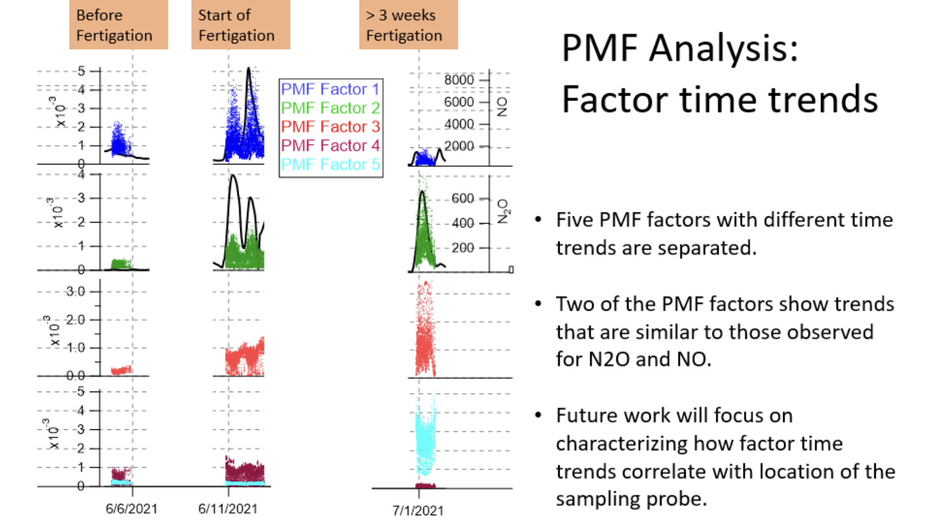
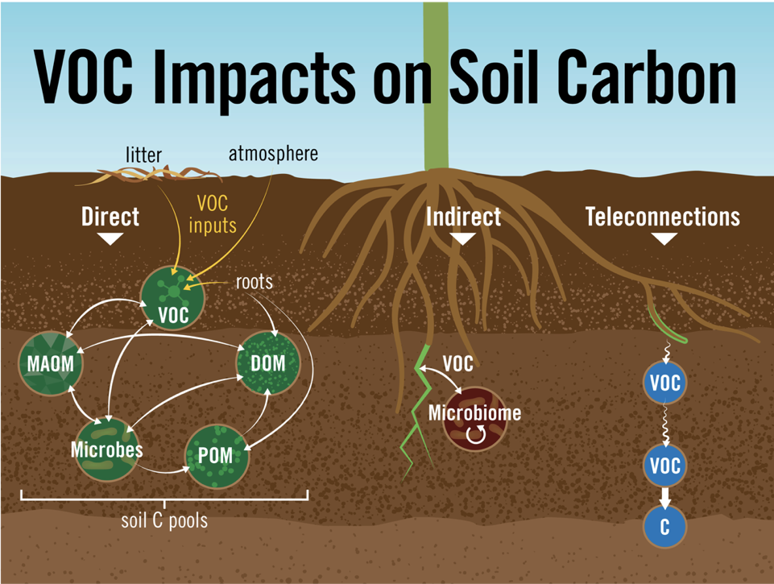
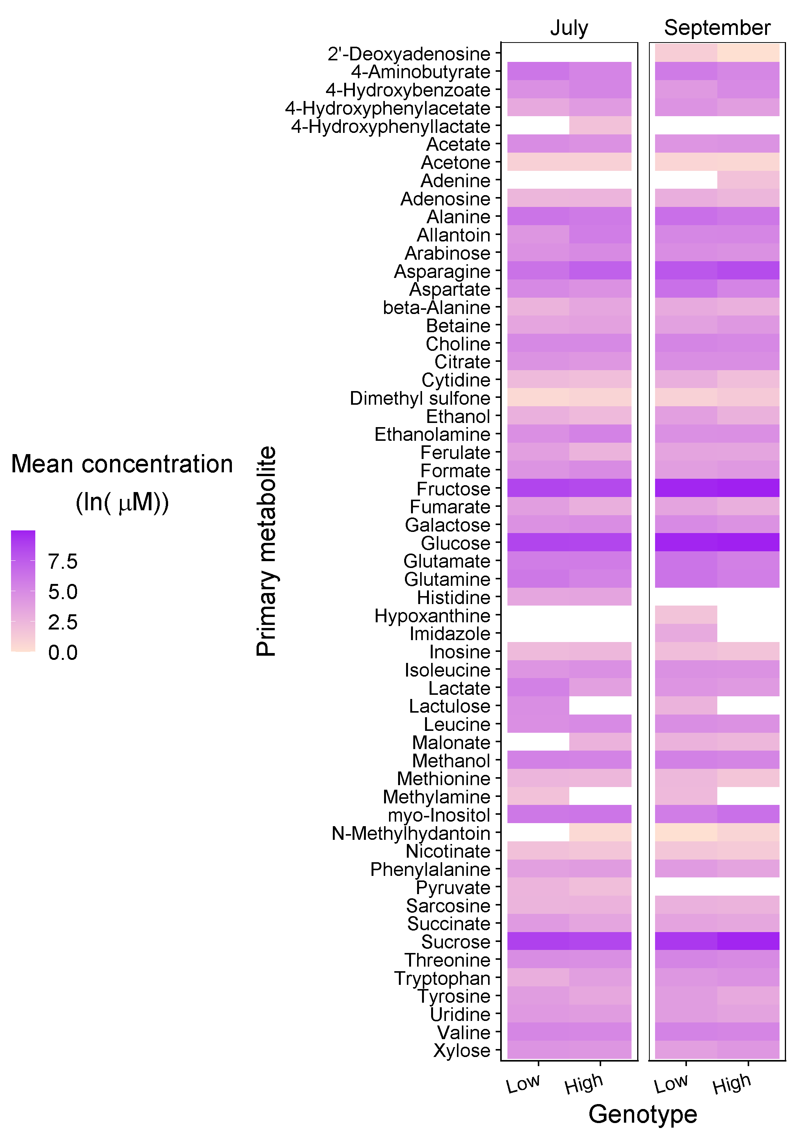
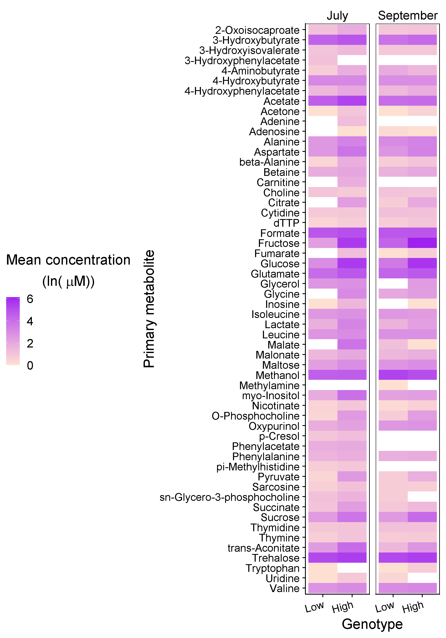
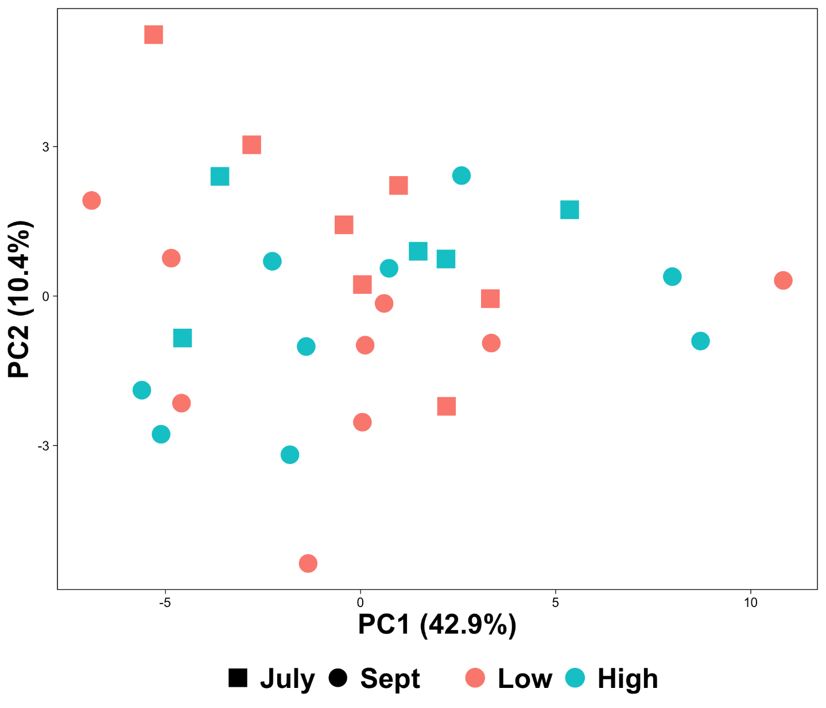
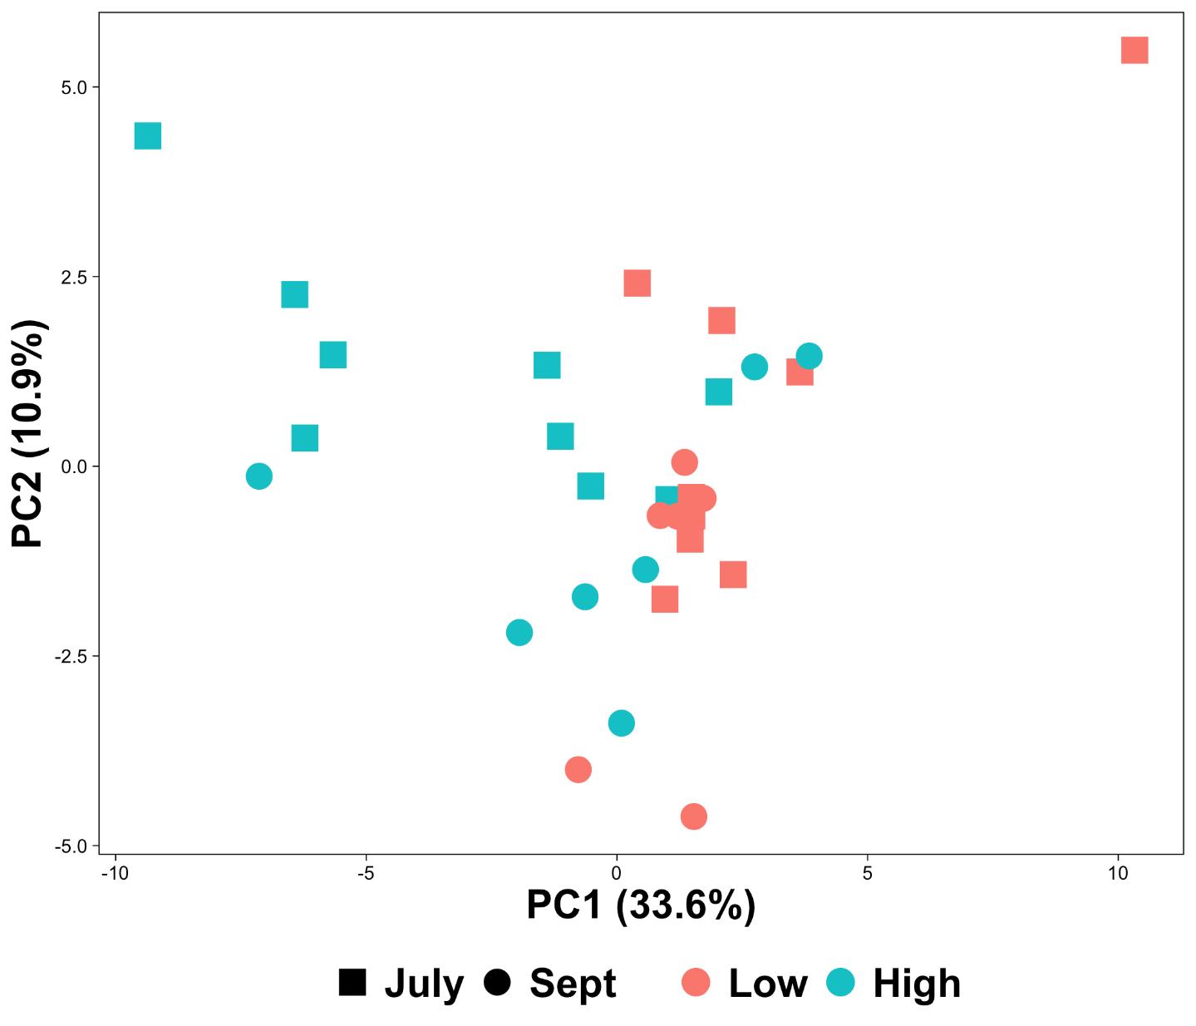
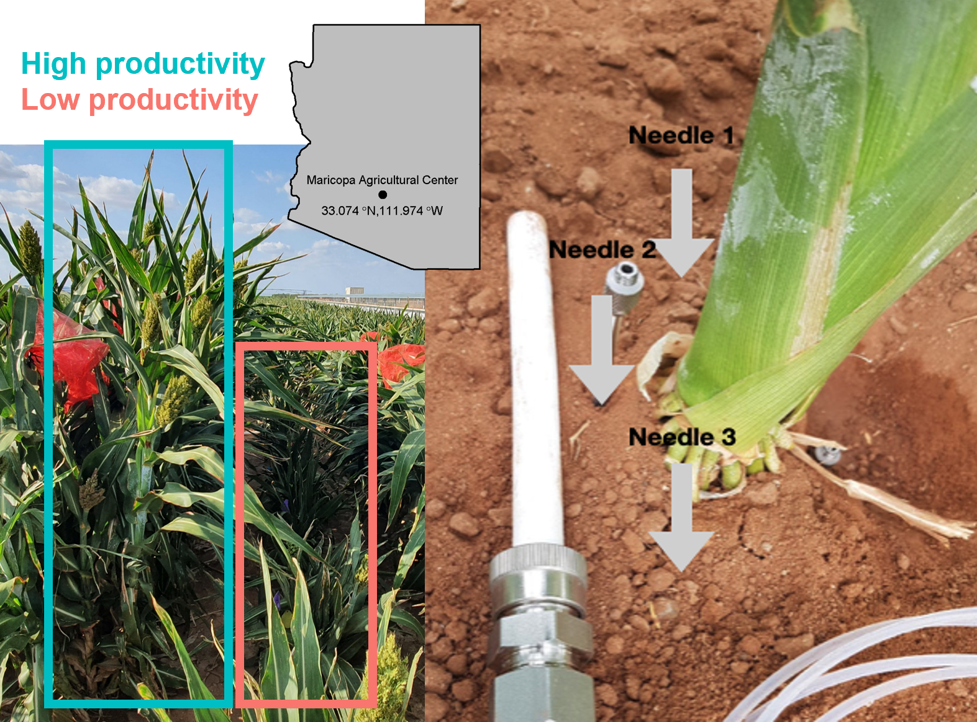
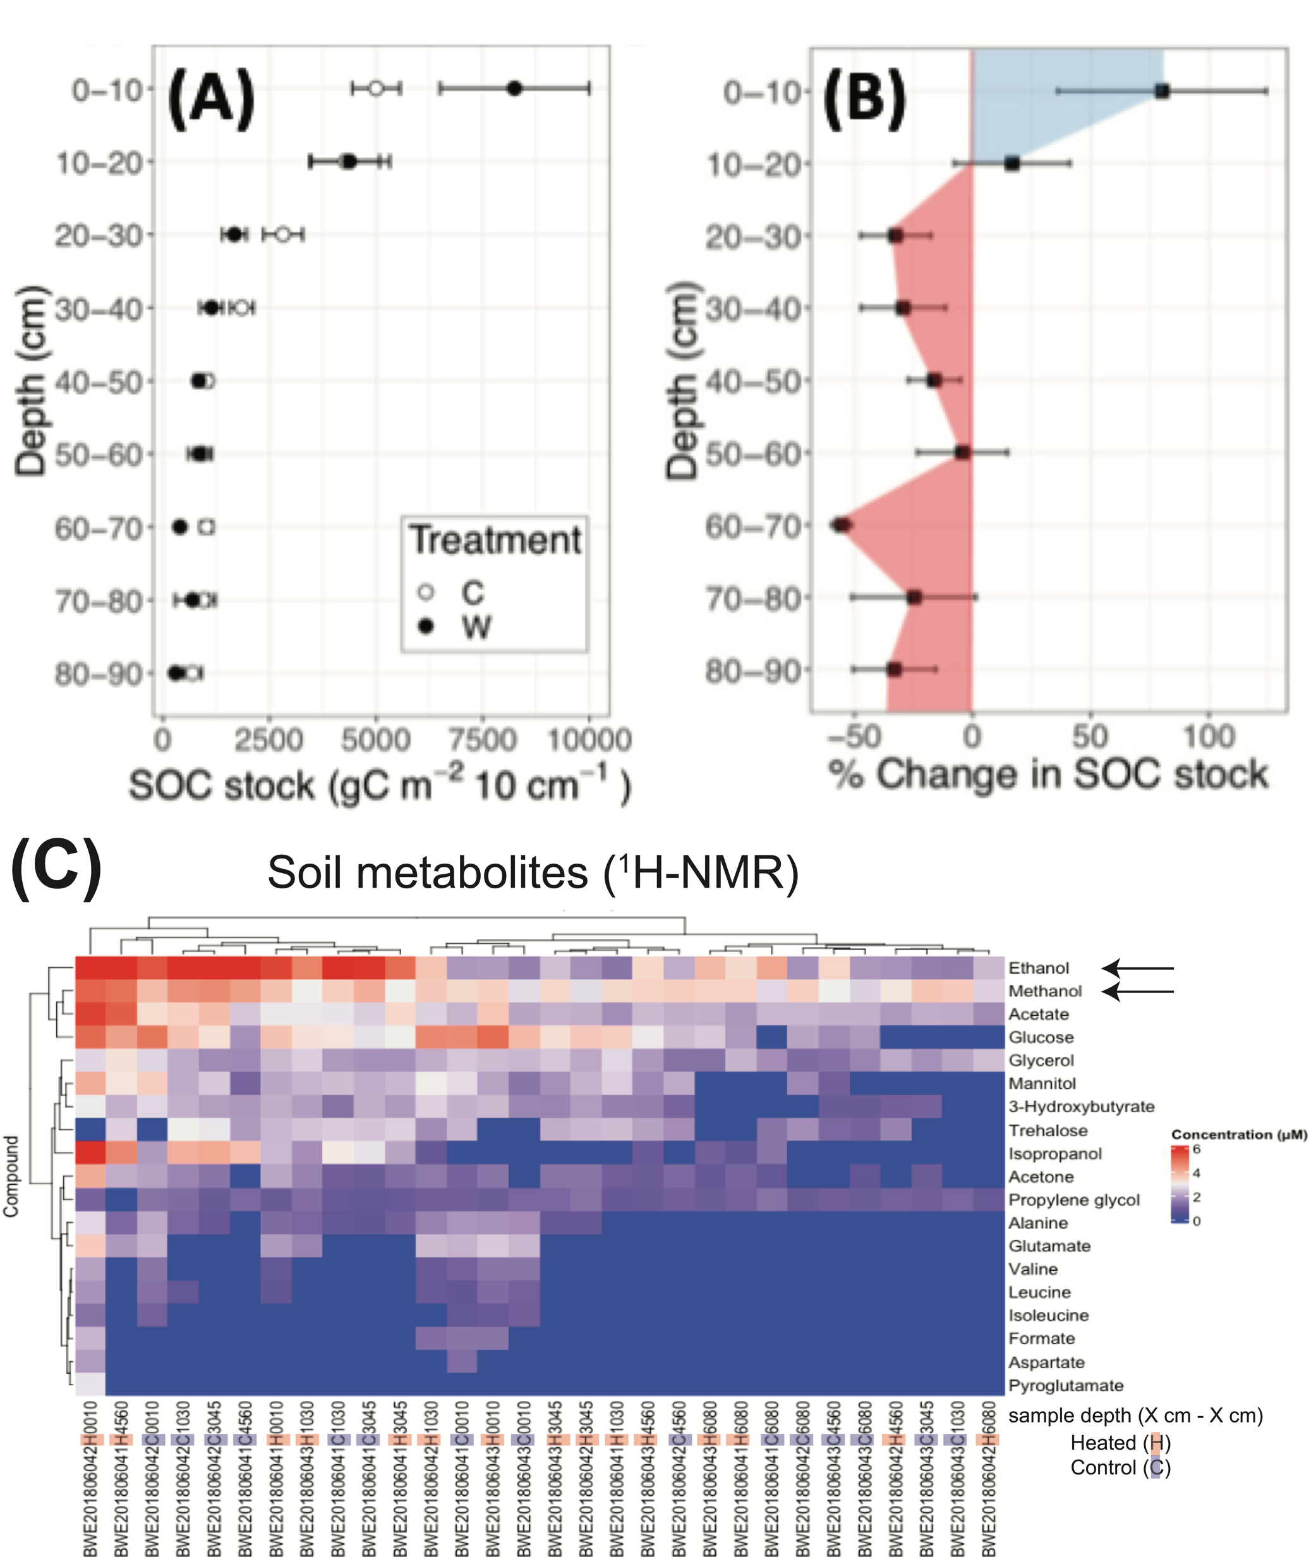

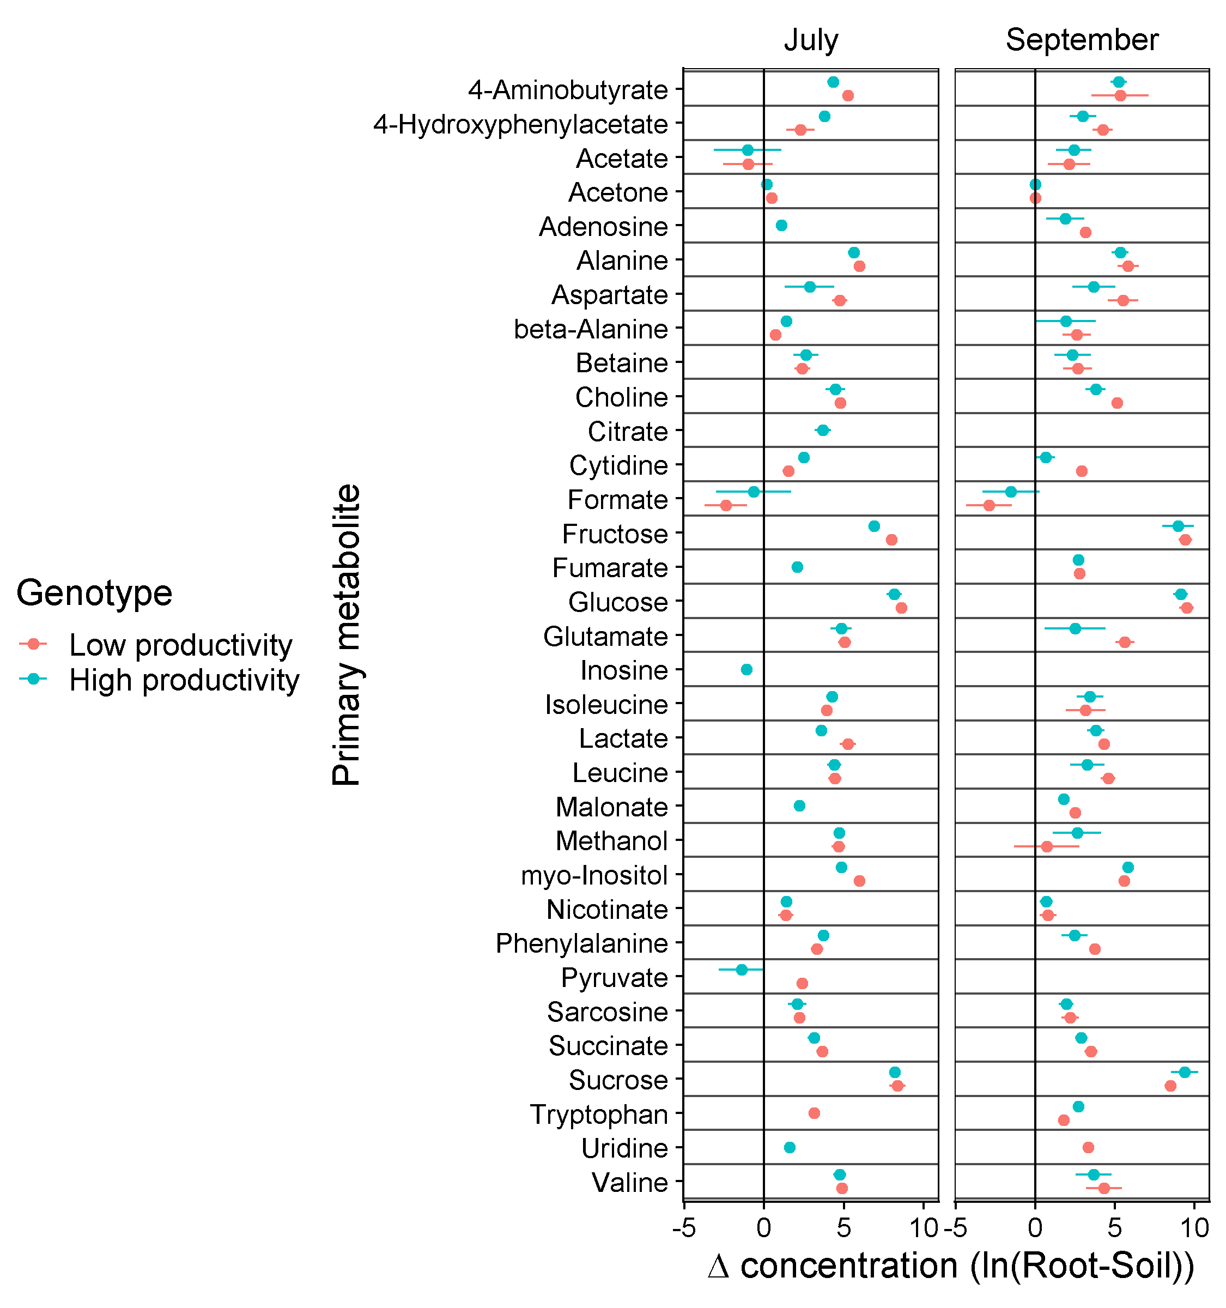
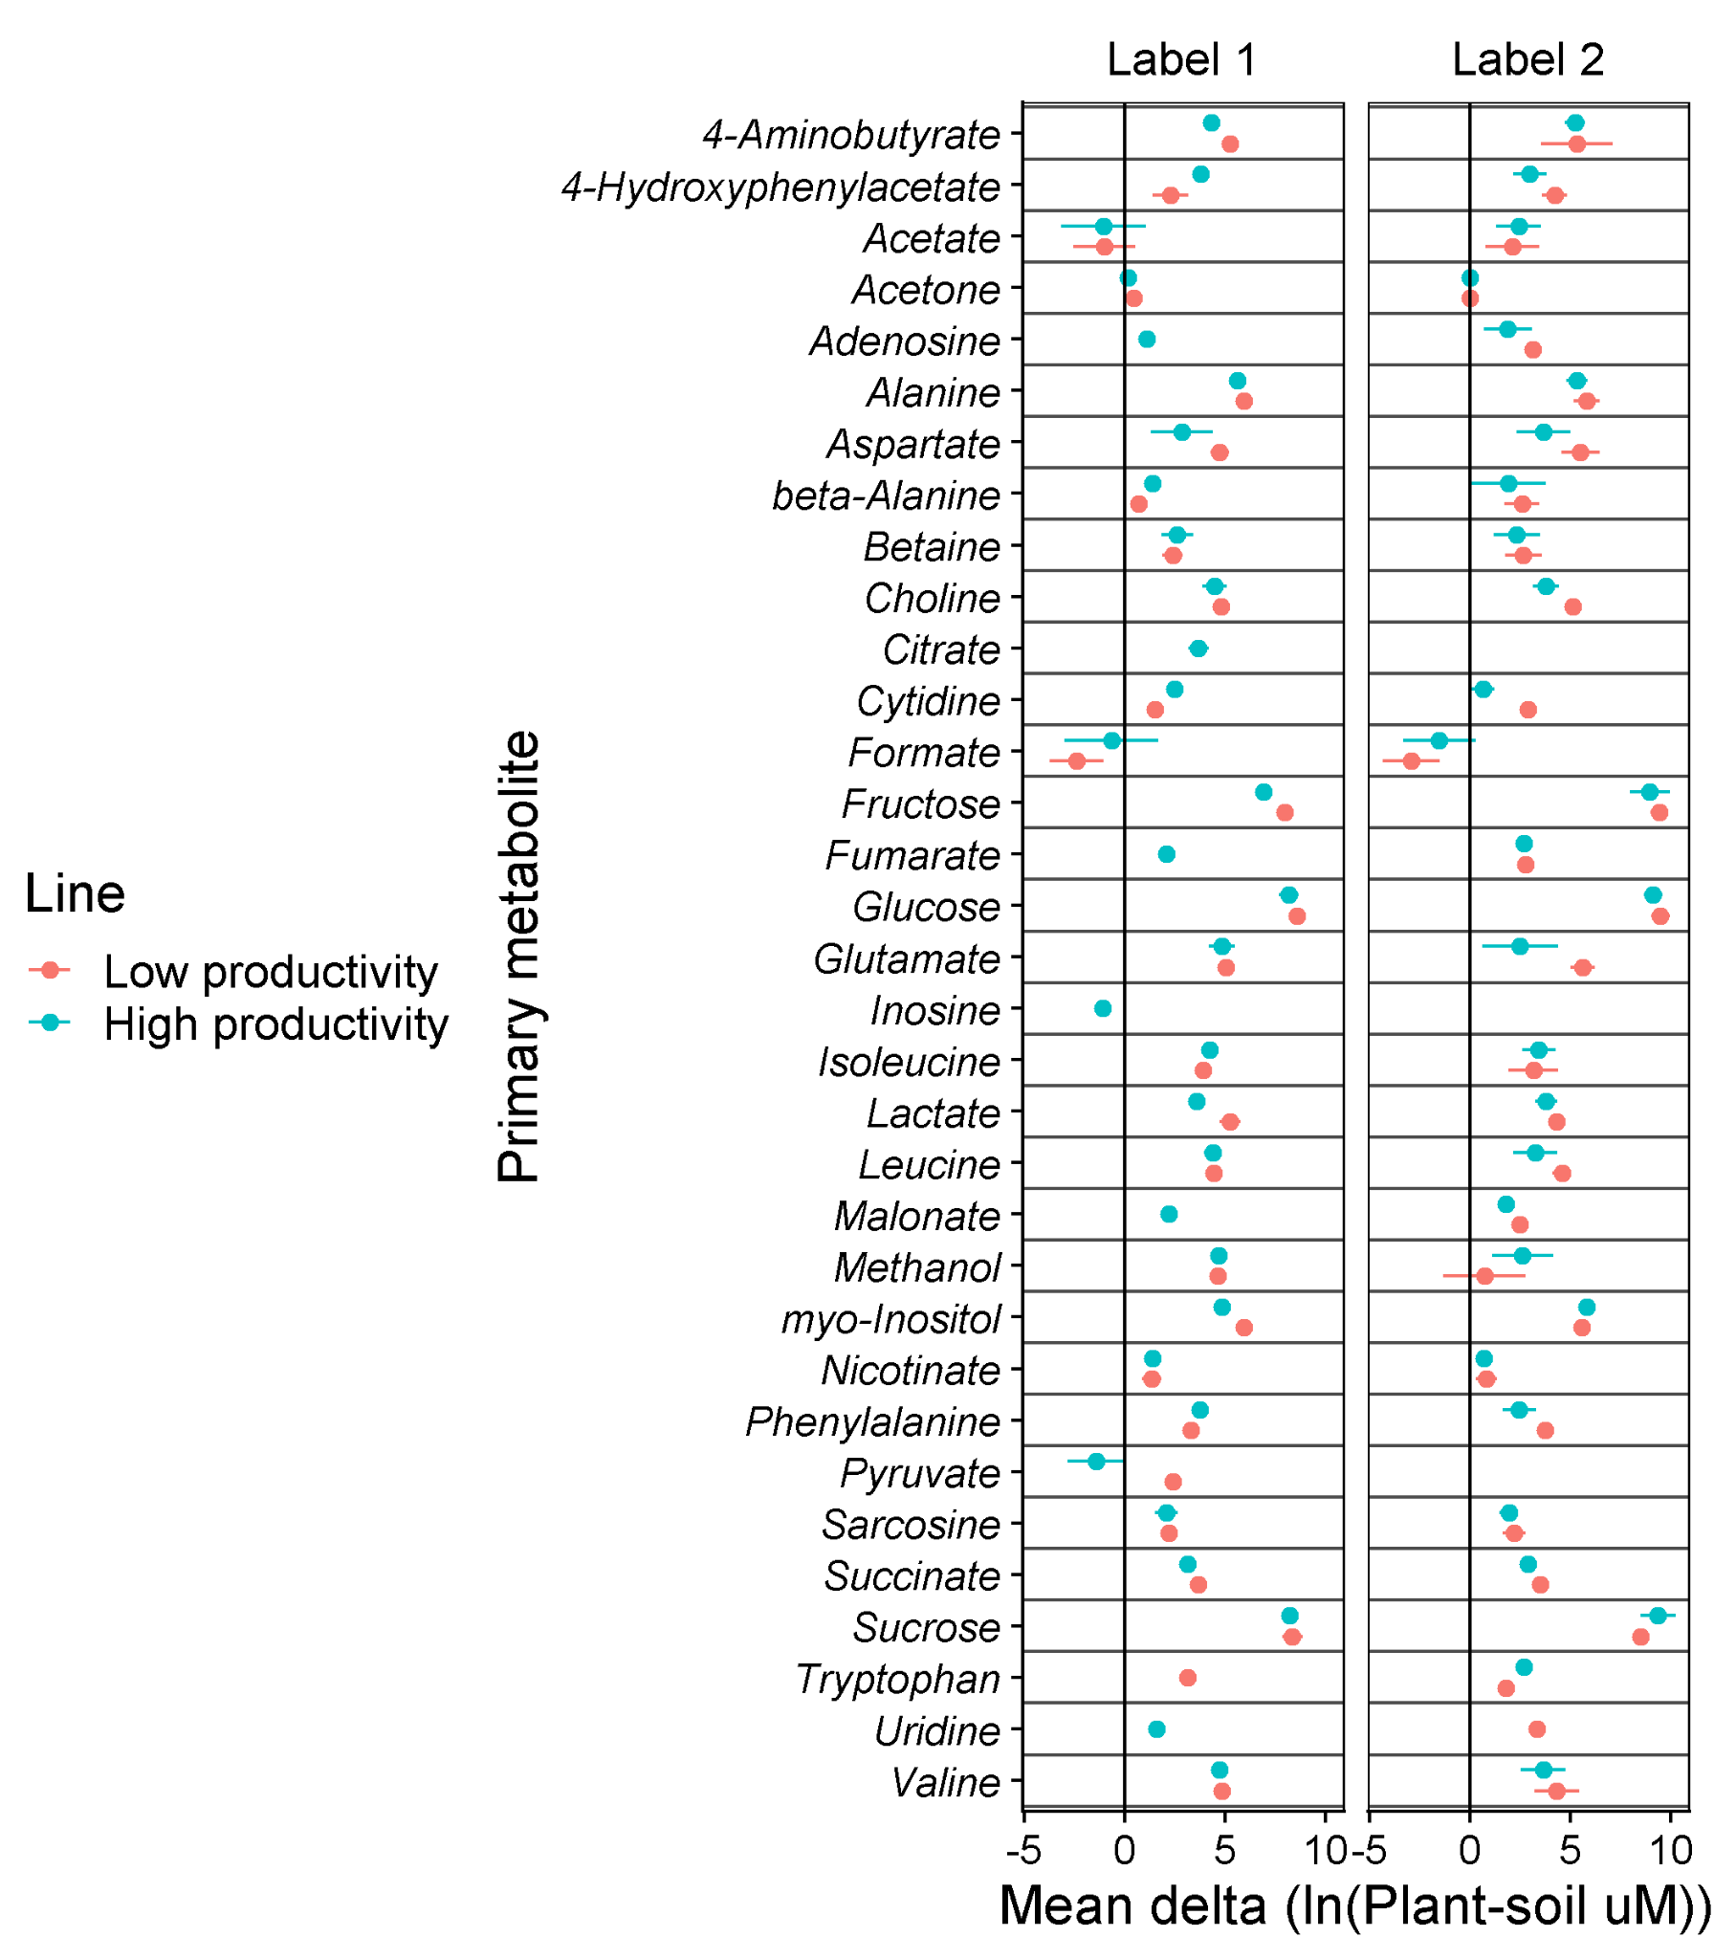
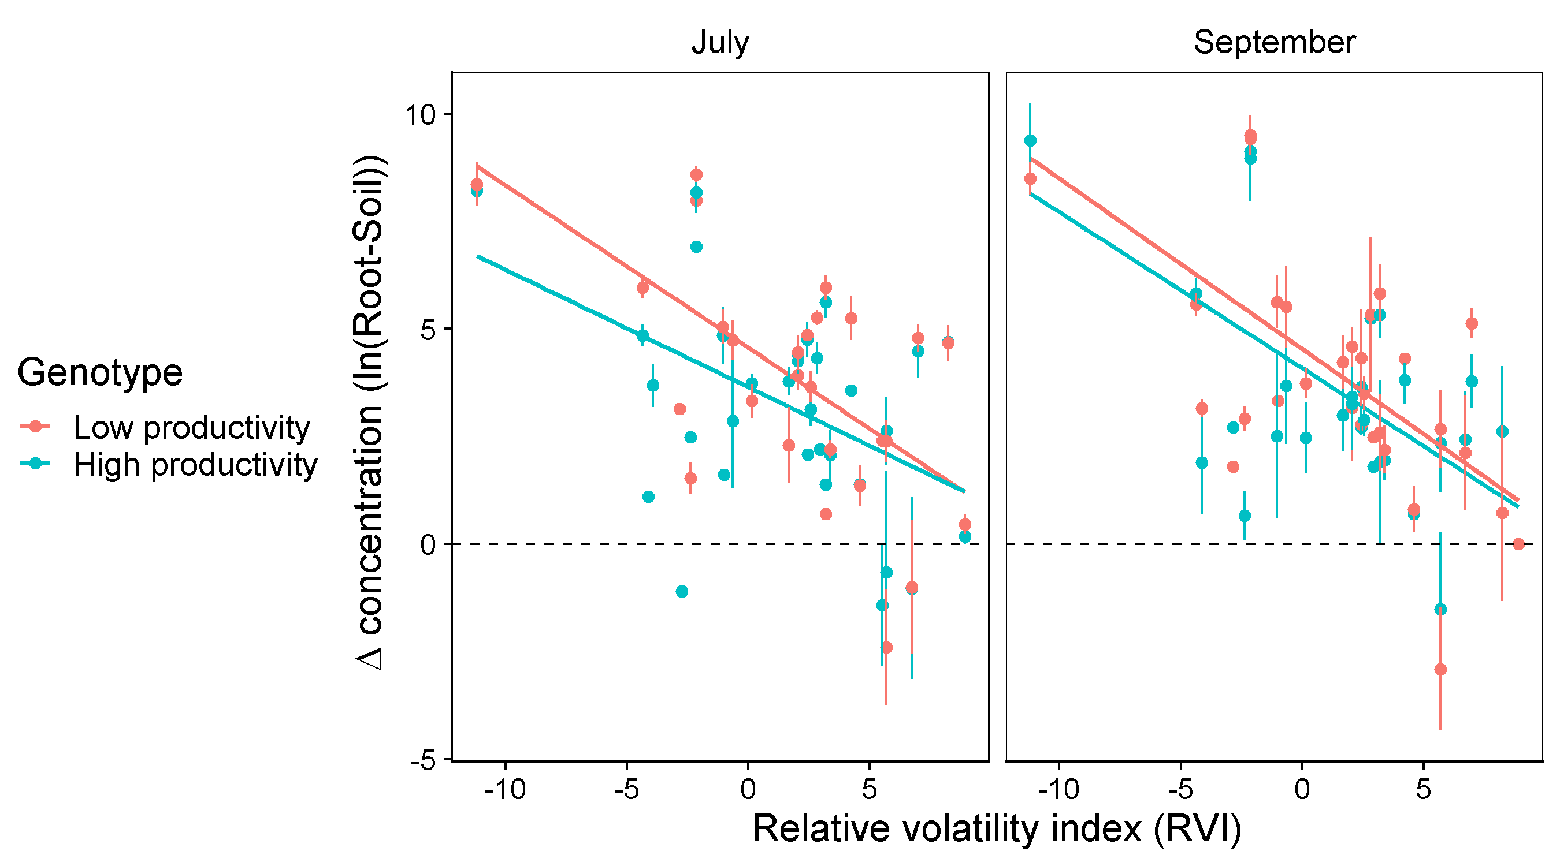
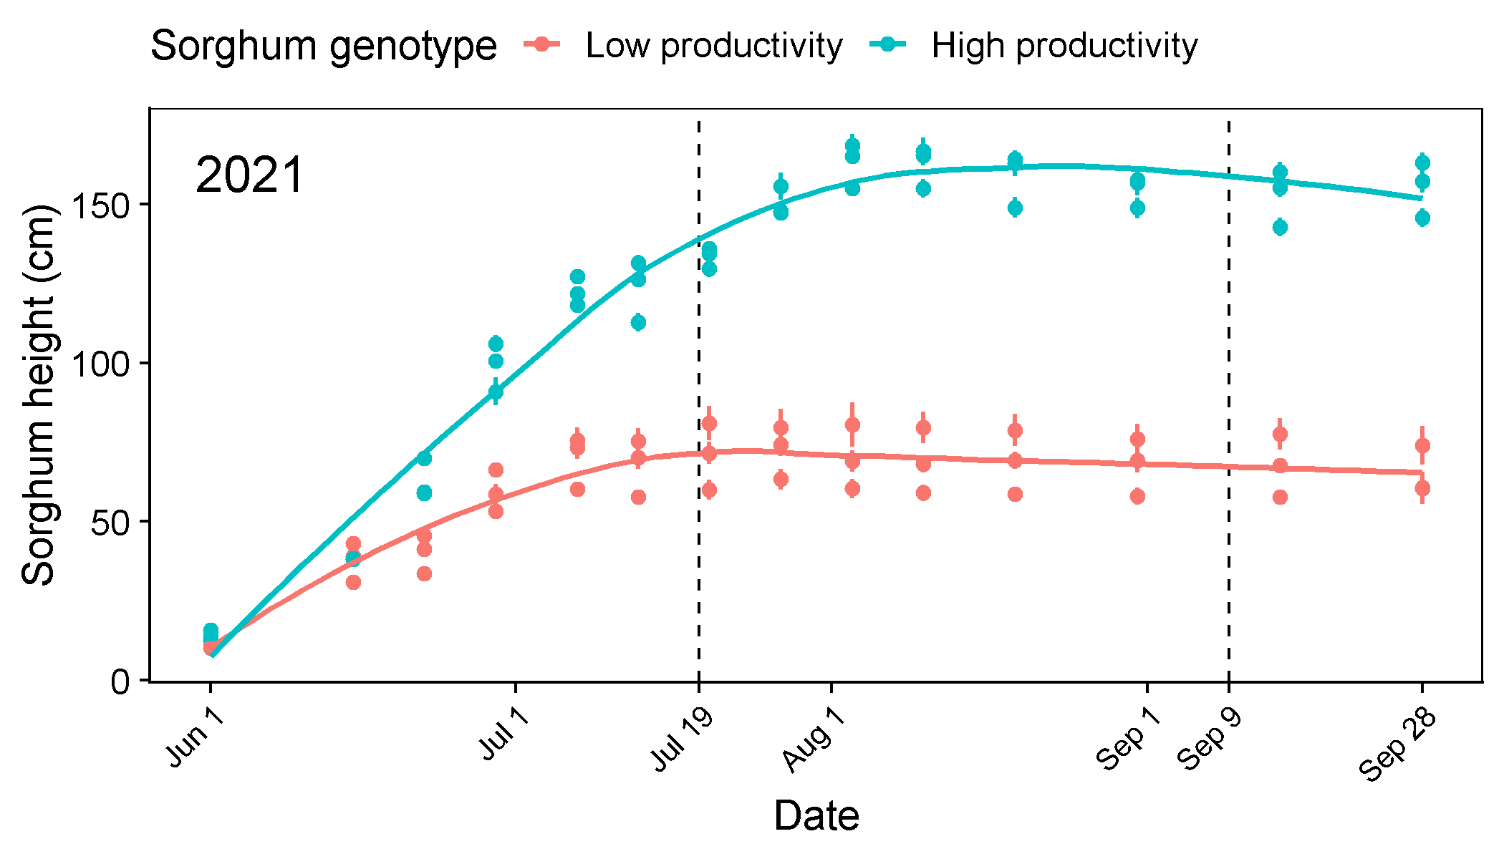

Root-Mediated Impacts of Plant Volatile Organic Compound Emissions on Soil Carbon
Linnea Honeker¹, Holly Andrews¹, Manjula Canagaratna², Elizabeth Lunny^{2,} Juliana Gil-Loaiza¹, Malak M. Tfaily¹, Jordan Krechmer², Megan Claflin², J. Rob Roscioli², Joanne Shorter², Duke Pauli¹, Jeffrey Demieville¹, Meara Clark¹, Justin Grigory¹, Robert Stanley³, Dusan Velickovic³, David Hoyt³, Robert Young³, Chaevien Clendinen³, Kolby Jardine⁴, Romy Chakraborty⁴, Margaret Torn⁴, Eoin Brodie⁴, and Laura K. Meredith¹
¹University of Arizona, Tucson, AZ; ²Aerodyne Research, Inc., Billerica, MA;
³Pacific Northwest National Lab, Richland, WA; ⁴Lawrence Berkeley National Lab, Berkeley, CA
RESULTS
INTRODUCTION
RESULTS
s
Our overarching project goal is to verify and quantify volatile organic compounds (VOCs) as direct and indirect contributors to soil carbon (C) stabilization within the rhizosphere and beyond through teleconnections in the soil matrix, and to determine their underpinning ecological and metabolic mechanisms. One of our objectives is to determine the direct pathways and contributions of root-released VOCs and VOC transformations by soil microbiomes to soil C cycling and stabilization.
Background. Plants are the dominant source of VOCs to the atmosphere, where they play critical roles in air quality and climate, yet the parallel impact of plant-derived VOCs on the pedosphere (soil) remains poorly quantified. Like VOCs released by decomposing litter, we hypothesize that root VOCs also contribute to soil C including those associated with C stabilization and may depend on plant physiological traits, rhizosphere microbes and their activity, and soil environmental factors. We characterized belowground VOCs in two distinct ecosystems to begin to address these unknowns.
Table 1. Total metabolite concentration increased over time in roots but not soil and were higher in high productivity plant soil but not roots. ‘Δ metabolome’ represents root vs soil concentration difference. n= 3 per group
Figure 6. Soil VOC groups showed different dynamics in the early growing season. Individual ions are grouped by positive matrix factorization (PMF) to understand overall trends in VOC composition. PMF 1 and 2 have similar dynamics to NO and N₂O, respectively. Next, we will analyze the high-resolution data for trends in specific VOCs and relationships between PMFs and plant productivity and time. Next campaign, methanol will be measured by proton transfer reaction time of flight MS.
Sampling date | Productivity genotype | Partition | Total metabolite concentration (µM) | Δ metabolome (Root-Soil (µM))
July 2021 (Pre-monsoon) | Low | Root | 21,750 ± 3696 | 20,918 ± 3719
Label 1 | Low | Soil | 749 ± 70
Label 1 (July 2021) | High | Root | 19,541 ± 5477 | 18,416 ± 5622
Label 1 (July 2021) | High | Soil | 1703 ± 316
September 2021 (Post-monsoon/ flowering) | Low | Root | 52,588 ± 10,890 | 54,595 ± 12,732
Label 2 | Low | Soil | 963 ± 72
Label 2 | High | Root | 62,331 ± 18,918 | 48,321 ± 23,652
Label 2 | High | Soil | 1552 ± 503
PTR-TOF-MS Total Signal
(A)
ROOT
(B)
SOIL
CONCLUSIONS
Figure 1. Pathways for VOC impacts on soil C
CONCLUSIONS
Both plant genotypes (high and low productivity) maintain a relatively consistent metabolism within their roots.
High productivity plants release more C into the surrounding soil, possibly reflecting higher assimilation rates and excess C shedding, leading to greater soil metabolite concentrations.
Volatile compounds are found in more consistent concentrations across the root-soil interface, suggesting enhanced movement out of roots and into the extended rhizosphere.
Methanol concentrations were higher in low productivity soil, which may suggest greater adaptation of methylotrophic microbes to root methanol in high productivity soil (TBD with metatranscriptomics).
*
*
RESEARCH QUESTIONS AND HYPOTHESIS
Do plants contribute to soil C pools?
We hypothesize that plant roots contribute to soil C pools, including from volatile compounds (VOCs).
Do plant physiological traits and rhizosphere microbes impact this VOC-C allocation to soil?
We hypothesize that plant physiological traits impact the amount and type of C exudated into the soil, and that rhizosphere microbes further modulate these releases through metabolizing plant root exudates.
Low High Low High
Low High Low High
FUTURE DIRECTIONS
(C)
ROOT
no significant drivers
(D)
SOIL
Next, our team will investigate VOC-C stabilization at the Blodgett Experimental Forest deep soil warming experiment. Preliminary data from this temperate coniferous shows abundant soil VOCs methanol and ethanol (Fig. 8) that may contribute to increased soil organic carbon (SOC) stocks in surface soils and/or become relatively more important C sources with increases in C-limitation at depth (Fig. 9)
We will also return to Maricopa to measure real-time changes in soil methanol in addition to other VOCs for sorghum with different belowground phenotypes.
Our long-term motivation is to transform our current conceptual understanding and predictive capacity of microbial systems and soil C stabilization to include important roles of volatile compounds.
Genotype: p = 0.085; Date: p = 0.138;
Genotype * Date: p = 0.013
MATERIALS & METHODS
(A)
(Β)
Sorghum rhizosphere injected with aqueous NH₄NO₃ on three consecutive days
Soil and root samples collected three days after third injection
Figure 4. Root metabolic profiles remain consistent over time and plant productivity (high vs low); however, high productivity plants release more exudates into rhizosphere soil leading to a smaller difference in metabolites for high vs low rhizosphere associated soil (* with a notable exception for methanol; this VOC was higher in low productivity in Sept.). Metabolic profiles illustrated by heatmaps for A) roots and B) soil and principal component analysis C) roots and D) soil.
Soils (10g) and roots (2g) undergo sequential H₂O and meOH extractions and flowed through SPE column
Extracts quantified using 1D and 2D ¹H-NMR
Figure 2. Sorghum lines were planted
in June 2021 at Maricopa Agricultural
Center (MAC) located in Maricopa, AZ.
Two genotypes were planted: high and low productivity lines.
In July (pre-monsoon) and September (post-monsoon, during flowering), fertilizer (NH₄NO₃) was injected in 3 locations around the base of plant. Soil probes were buried at two depths for online VOC measurements. B) Flowchart showing sample collection and processing for NMR, performed at PNNL.
(A)
(B)
Figure 8. Soil VOCs are abundant in control and heated soil plots, and may play a role in soil carbon responses to deep warming.
(A)
Low
Plant height
(B)
(C)
High
p = 0.13
p = 0.02
*
AKNOWLEDGEMENTS
High: R²=0.21; p=0.007
Low: R²=0.36; p=0.008
High: R²=0.34; p=0.008
Low: R²=0.37; p=0.003
This research was supported by the DOE Office of Science, Office of Biological and Environmental Research (BER), grant nos. DE-SC0023189 and DE-SC0018459. A portion of this research was performed on a project award 10.46936/fics.proj.2021.60045/60000398 under the FICUS program and used resources at the DOE Environmental Molecular Sciences Laboratory, a DOE Office of Science User Facility sponsored by the BER program and operated under Contract No. DE-AC05-76RL01830. Part of this work was also performed at Lawrence Berkeley National Laboratory supported by the U.S. Department of Energy, Office of Science, Office of BER under Contract No. DE-AC02- 05CH11231.
Figure 3. High and low productivity genotypes differ in aboveground phenotypes (photosynthesis, plant height) but had similar belowground root traits. A) Plant height over time. Dashed lines indicate fertilizer injection and sampling timepoints. B) Photosynthetic capacity as indicated by chlorophyll A. C) Root height and widths. Bars indicate standard errors.
Figure 5. The mean differences in metabolite concentrations between roots and soil decrease with compound volatility, indicating that roots may be more prone to exude volatile compounds to the soil, while holding on to those with lower volatility. A) Mean deltas of metabolites across time. B) Regression of mean deltas vs relative volatility index (RVI).
Notes:
Put metabolies in order of volatility
Add monsoon, etc. to Plant height timeline?

